Slide 1


ISWA 2026 · Working Group 18 · Bern, 7 July
Exploring risk pathways and safety measures during the high-risk bovine periparturient period
A Survivor-Informed Study
Kirsty Sweet¹ · Francis Bligh² · John McNamara² · Sinéad Flannery¹
¹University College Dublin · ²Teagasc, Ireland
WG18: Documenting strategies of preservation in agricultural work — this paper examines how farmers preserve health, quality of work, and relationships with living beings during the high-risk calving period, where care and danger are closely entangled.

Slide 2
Why This Matters
19%
33%
47%
of all Irish workplace
fatalities involve livestock
(HSA, 2011–2020)
of livestock fatalities now
involve cow attacks
(HSA data; up from 16%, 1996–2005)
of farm accidents involve
livestock (2022 Teagasc
National Farm Survey)
The gap:
Formal safety guidance rarely reflects the lived reality of on-farm decisions at calving-time. Risk is embedded in necessary, routine work — not only in exceptional events. This study asks: how do incidents unfold in practice, and how do farmers navigate the tension between care and self-preservation?

Slide 3
Research Aim and Questions
Understanding how periparturient incidents arise — and supporting context-sensitive prevention
01
02
03
Identify incident precursors
Explore the advisory role
Co-develop KT resources
What recurring conditions drive attacks and near-misses?
How can advisors support safety at calving-time?
Which KT tools strengthen advisory practice and on-farm decisions?

Slide 4
Methodology: A Survivor-Informed, Multi-Method Qualitative Design
Stage One
Stage Two
Exploring & Modelling Risk Pathways
Developing Knowledge-Transfer Resources
1
Semi-structured interviews
n = 16 farmers across Ireland with lived experience of periparturient incidents or near-misses
4
Advisor focus discussion group
n = 9 Teagasc bovine livestock advisors — shaping KT prototype resources
2
Accident sequence reconstruction
Reconstructing each narrative: pre-incident conditions → triggers → constraints → outcome
→
5
Iterative design review workshops
n = 13: farmers (n=3), advisors (n=5), H&S professionals (n=5)
3
Fault Tree Analysis (FTA)
Formalising recurring pathways across cases — identifying how conditions interact to produce the top event
6
Four prototype KT tools co-developed
Farm walk-through tool · Calving companion sign · Calving awareness map · Near-miss reflection sheet

Slide 5
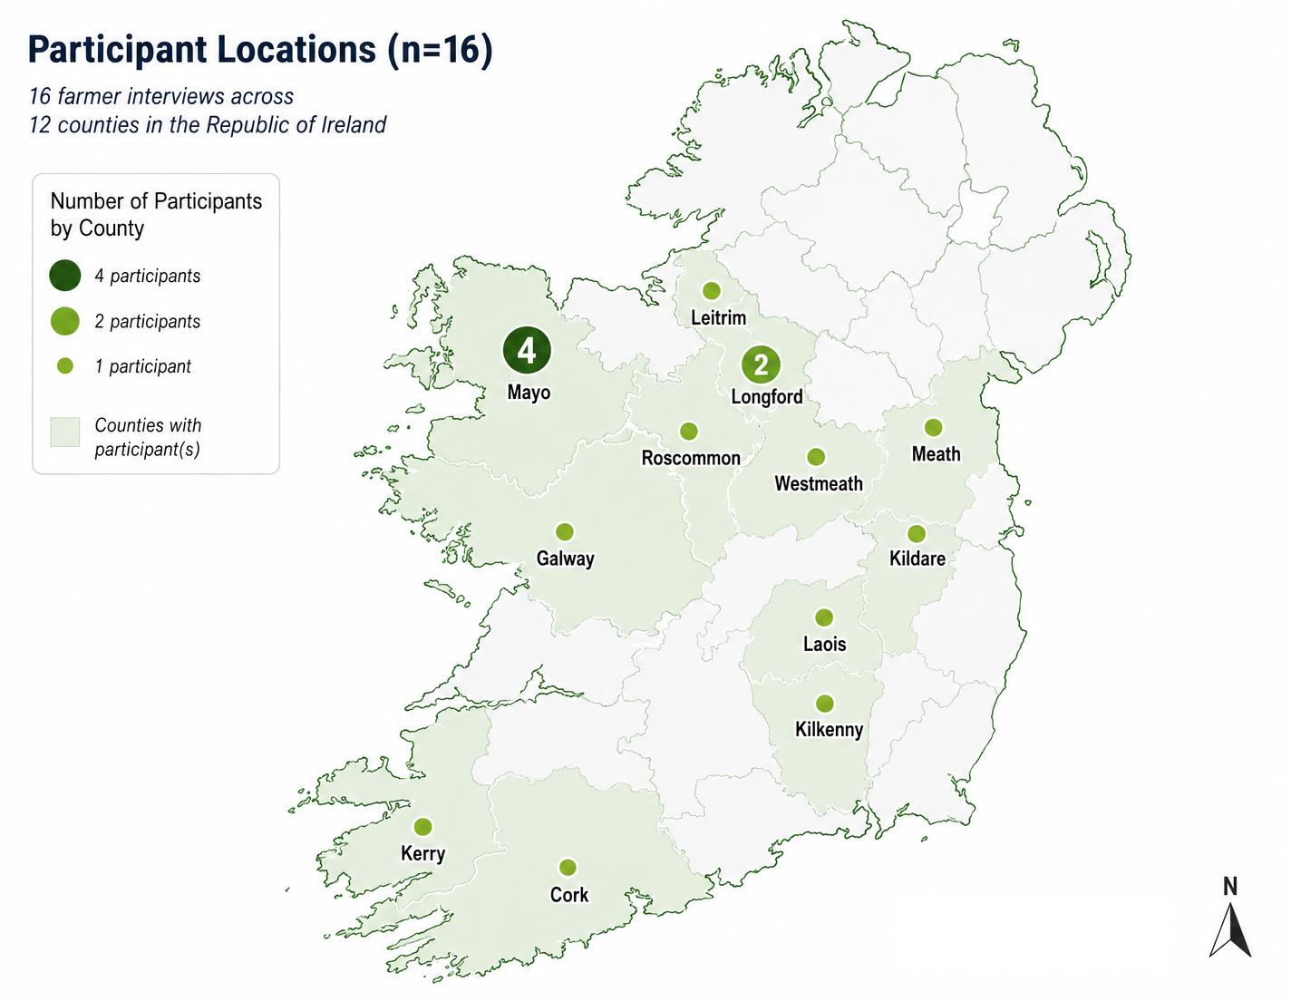
Study Location and Sampling Strategy
16 farmer interviews conducted across the Republic of Ireland
Sampling Strategy
Purposive, criterion-based sampling: farmers with lived experience of a bovine periparturient incident or near-miss
Recruited via Teagasc advisory network, Teagasc newsletters and online coverage, and face-to-face recruitment
Recruitment was broadened nationally to reach the required farmer sample after limited advisor-mediated recruitment
Republic of Ireland

Slide 6
Understanding Incidents: Fault Tree Analysis
An engineering safety-science method, applied here to a lived, on-farm context
What FTA Is
Why It Suits This Study
A deductive systems-modelling method for how multiple conditions combine to cause an undesired event (Kingman and Field, 2005)
Starts from a defined "top event" and works backwards to its underlying causal factors (Kingman and Field, 2005)
Logic gates (e.g. AND) show how several conditions must converge for the event to occur (Kingman and Field, 2005)
Applied after accident sequence reconstruction of each narrative into conditions, triggers and outcomes (Dekker, 2002)
Periparturient incidents resist single-cause explanations — FTA is built for exactly this kind of multi-condition convergence
Allows us to formalise survivor accounts into recurring pathways, without flattening individual narratives into a single story
Surfaces where barriers are missing or compromised, pointing directly to actionable prevention points
Bridges qualitative, survivor-informed data with a structure advisors and safety professionals already recognise

Slide 7
Main Finding: Risk Pathways at Calving-Time
Incidents do not arise from a single cause — they emerge through the convergence of three necessary conditions (AND-gate logic)
Maternal Defensive
Behaviour
Close Human
Proximity
Limited or Compromised
Controls
Heightened reactivity, vigilance, and protective responses — especially during calf-related tasks (tagging, weighing, reuniting)
Necessary for monitoring, calving assistance, and routine post-calving interventions — requires entry into the cow-calf space
Inadequate separation, poor facility design, absence of barriers, or lack of safe withdrawal and egress routes
AND logic
PERIPARTURIENT INCIDENT OR NEAR-MISS
Once hazardous proximity was established, escalation was frequently rapid and difficult to reverse — emphasising the limits of purely reactive strategies.

Slide 8
Strategies of Preservation
Farmers actively developed protective strategies — often partial, but real
Maintaining distance
Using or improvising barriers
Staying outside the reactive zone where the task allowed
Gates, headgates, and partitions — improvised when needed
Planning entry and exit routes
Reading animal cues
Identifying withdrawal paths and task sequence before entering
Ear position, stance, vocalisation, proximity to calf as early signals
Learning from incidents
Drawing on advisory and peer support
Adapting practices, facilities, and routines after near-misses
Guidance from advisors, peers, or family; sharing near-misses in trusted networks

Slide 9
Scales of Preservation
Preservation strategies operate across multiple scales — from the immediate task to farm organisation to wider support systems
TASK LEVEL
The immediate moment of work
Body positioning · Entry and exit timing · Reading animal cues · Escape planning
FARM LEVEL
Work organisation and physical environment
Calving pen design · Labour availability · Facility investment · Task sequencing
WIDER SUPPORT SYSTEM (AKIS)
Advisory, peer, and policy networks
Advisory services (Teagasc & private advisors) · Knowledge-transfer tools · Grant supports (TAMS) · Peer learning

Slide 10
Relationships with Living Beings and Work Organisation
Care and danger are entangled
Work organisation shapes exposure
—
Care work happens at moments when the relationship can turn dangerous
—
Lone working intensifies risk — no one to assist or distract
—
Tagging, weighing, treatment all require unavoidable proximity
—
Time pressure crowds out planning; falls back on habit
—
Preservation is relational — self, care, and animal welfare at once
—
Familiarity reduces risk salience; maternal behaviour shifts fast
—
Care and self-protection are intertwined, not separate
—
Near-misses rarely reported — invisible in formal safety systems

Slide 11
Conclusion
01
Periparturient incidents are systemic, not individual failures — they arise through the convergence of interacting conditions embedded in necessary work, and are preventable when multiple barriers are strengthened simultaneously
02
Preservation strategies exist and matter — farmers actively navigate care and danger together, but these strategies are partial, often invisible, and need to be supported structurally, not simply expected of individuals
03
Prevention requires alignment across scales — facility design, work organisation, and advisory support must work together. Where structural constraints remain, messaging alone is unlikely to be sufficient
Limitations & future research
The gendered dimension lies beyond this dataset — dedicated, gender-sensitive research is needed to examine differentiated strategies of decision-making and preservation of women and men.
Discussion question for WG18:
How can we document preservation strategies in ways that recognise both everyday skill and structural constraint — without reducing farmers to either heroic adapters or individual failures?

Slide 12
Thank you
ISWA 2026 · Working Group 18 · Bern, 7 July
Questions & discussion welcome
Kirsty Sweet¹ · Francis Bligh² · John McNamara² · Sinéad Flannery¹
¹University College Dublin · ²Teagasc, Ireland
I’d welcome your questions, and I’m glad to talk further with anyone working on farmer safety, advisory practice, or knowledge-transfer resources.
Kirsty Sweet · kirsty.sweet@ucdconnect.ie

